Slide 1
Reverse Engineering to Estimate Subsurface Utility Infrastructure Density
for Financing Smart City Infrastructure
Final presentation
PRESENTED BY : Yutong Lan, Zihao Liu, Zihao Wu
SPONSOR : Terri C. Matthews - Director, Town+Gown, NYC DDC
ACADEMIC PROJECT MENTOR: CUSP Prof. Debra Laefer
07/12/2023

Slide 2
Meet Our Team!
Terri C. Matthews
Director, Town+Gown, NYC@DDC
Debra Laefer
Academic Project Mentor, NYU
Yutong Lan
CUSP Student, Econ Background
Zihao Liu
CUSP Student, Math Background
Zihao Wu
CUSP Student, Finance Background
Notes:
We would like to give thanks to terri matthew, our project sponsor who is the director for Town+Gown at New York City Department of Design and Construction.
We would also like to thanks professor laefer, our academic project mentor,

Slide 3
Stakeholders
Government Agencies
NYC Department of Transportation
NYC Department of Environmental Protection (Public Utility)
NYC Department of Information Technology & Communications
NYC Department of Design and Construction
NYC Department of City Planning
Metropolitan Transportation Authority
Private Utilities
Con Edison
National Grid
Verizon, Spectrum, and others
Members of the Public
Residents
Business Owners
Elected Officials/Community Boards
Notes:
So these are some of our stakeholders, organized into three different categories. First, government agencies such as the NYC Department of transportation and NYC Department of environmental protection.
Private utilities like con Edison and National Grid.
And last but not least, members of the public.

Slide 4
Table of Contents
Introduction
Findings
Literature Review
Methodology
Data
Case Study
Related Project Resources
Conclusions/Recommendations
Acknowledgements
References
Estimated report time: 30mins

Slide 5
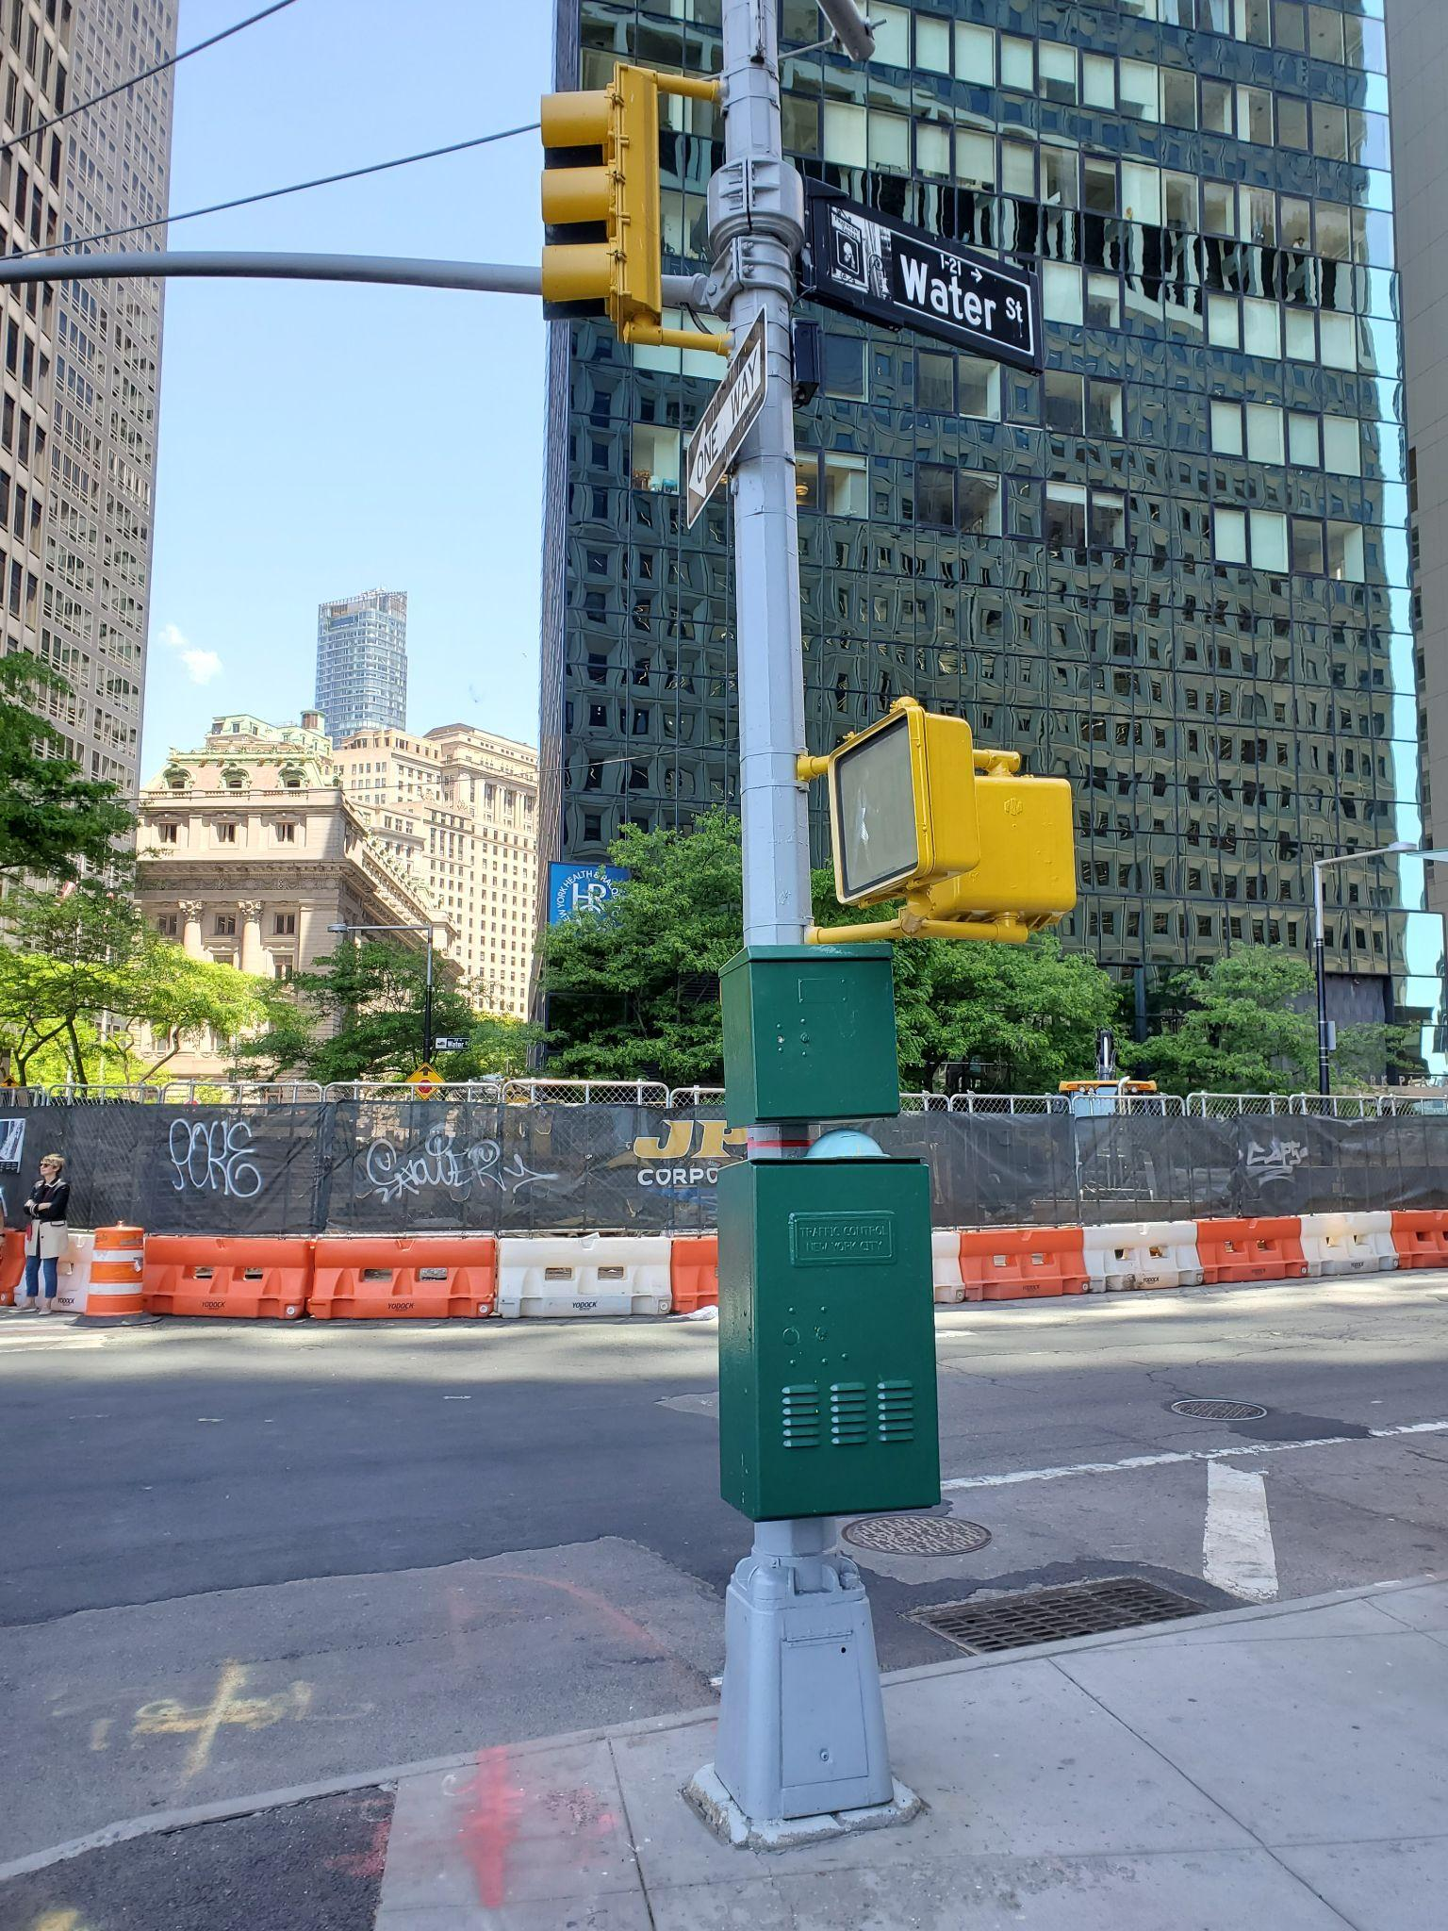
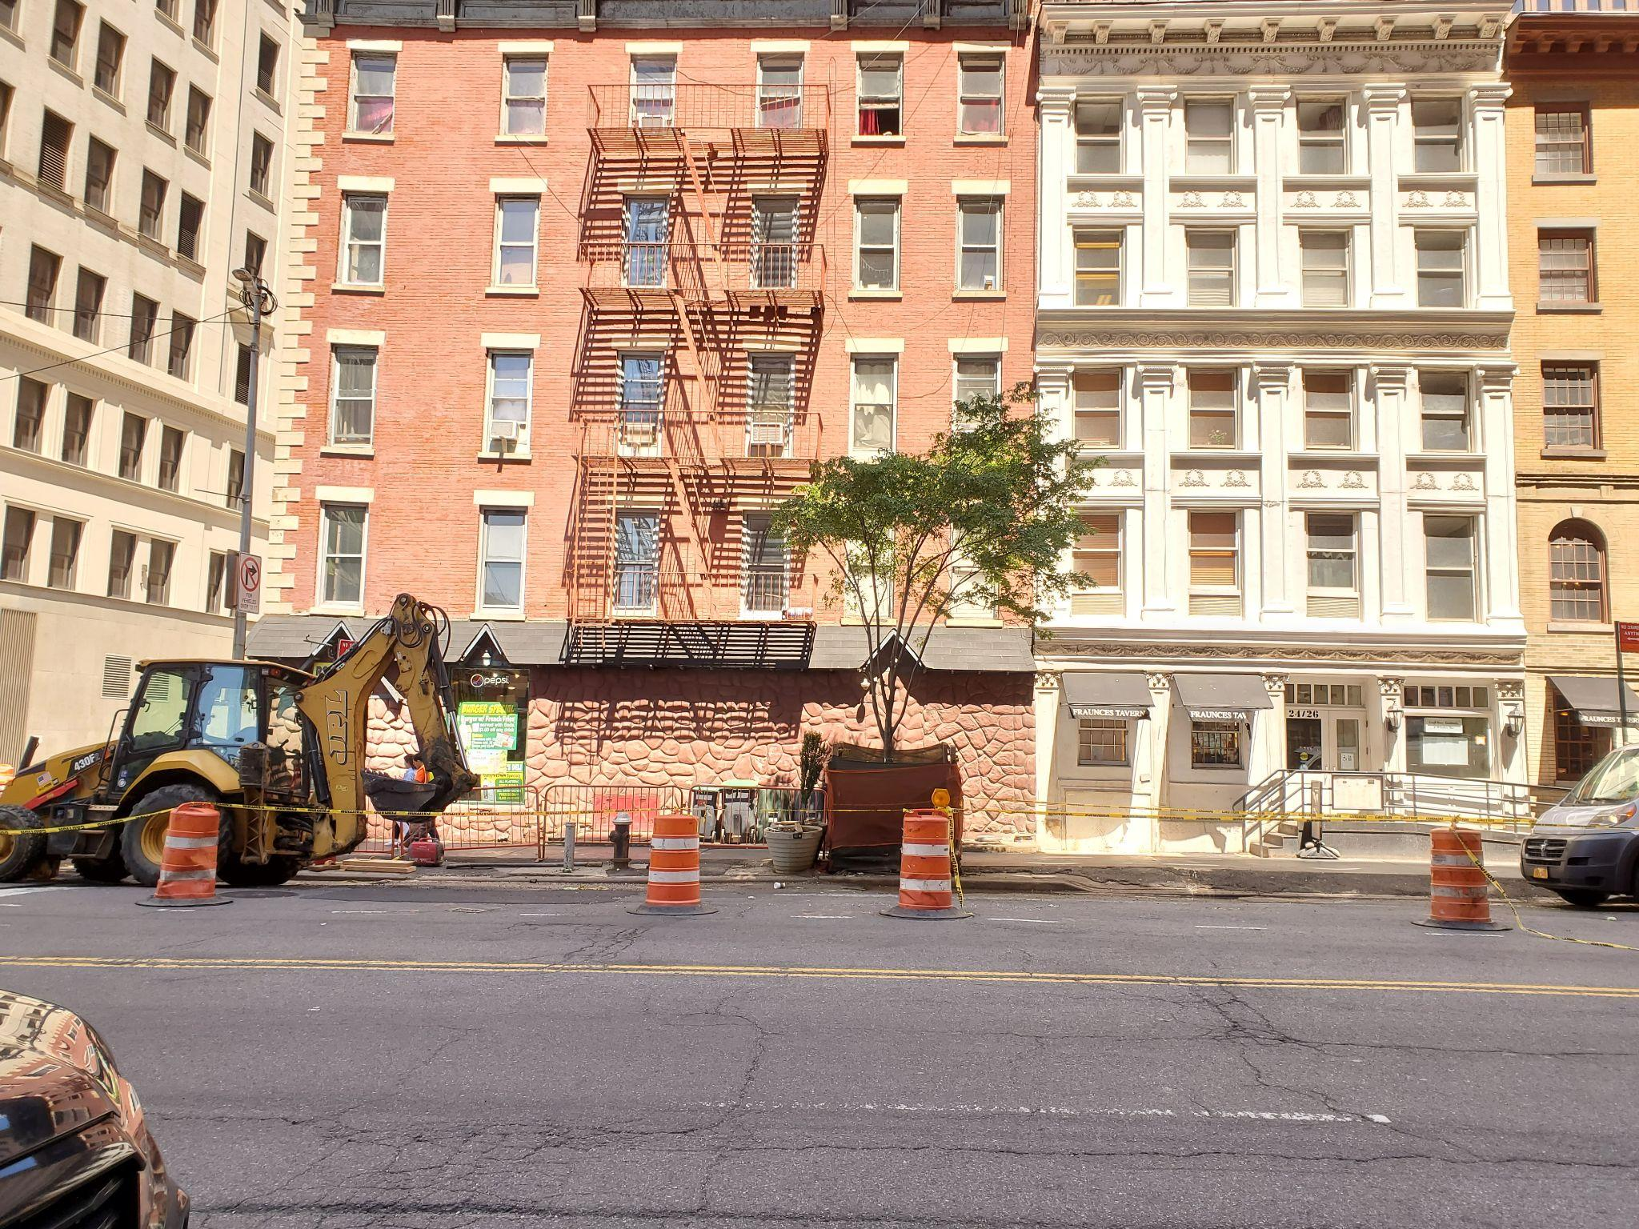
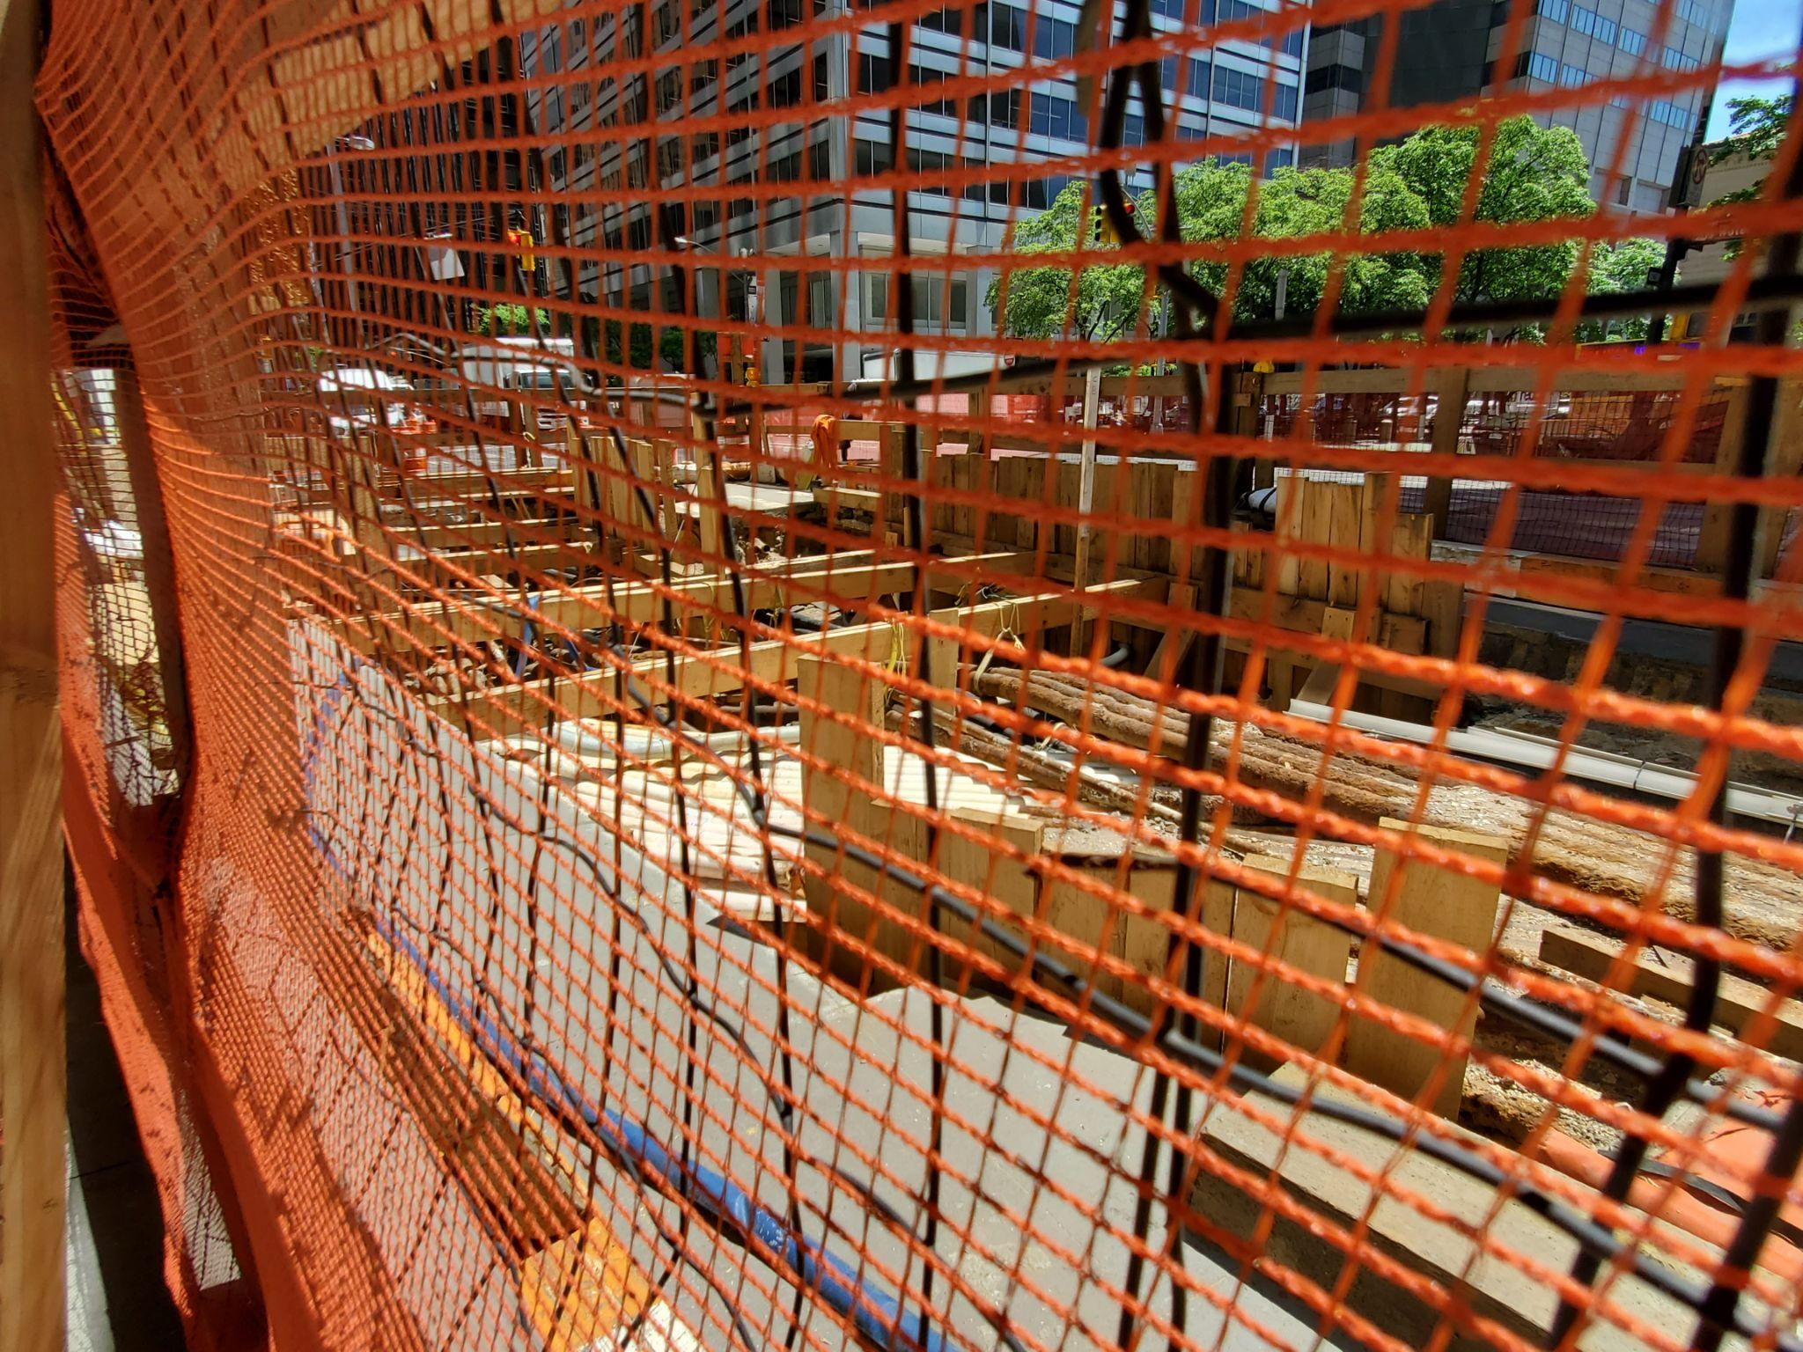
Why Are We Doing This?
Figure 1. Water Street in Manhattan. Photo: T.Matthews, 2023
Figure 2. Street excavation equipment parked on Water Street. Photo: T.Matthews, 2023
Figure 3. These can be avoided if we have subsurface utilidors! Photo: T.Matthews, 2023
Notes:
It is because the increasing age of subsurface infrastructures need to be addressed and well managed.
As these infrastructures age, they become more vulnerable and can create lots of potential risks and inconveniences.
As you can see in figures 1 and 2, there are already a lot of excavations that are going on today on the streets of New York, all trying to fix the old infrastructures and the number of excavations are currently only expected to rise.
However, these can be avoided if we have subsurface utilidors!
In addition, the city's complex network of subsurface utility infrastructure, often referred to as the "subsurface Spaghetti," presents a formidable obstacle for utilities operating in this environment.

Slide 6
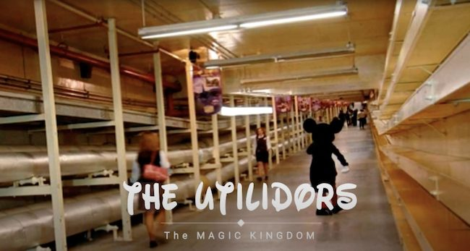
What is Utilidor?
Utilidor is an underground utility access system used primarily for the location of various utility transmissions infrastructure assets, which permits easier access for their maintenance without repeated street excavation. Utility transmission assets can include services for water, electricity, gas and telecommunications.
Located underground, typically under the roadway, the utilidor provides a convenient way to manage and maintain this infrastructure while reducing disruption to surface traffic on roads and sidewalks.
Figure 4. Disney Magic Kingdom Utilidors. Adapted from “Beneath The Magic: What Happens In The Magic Kingdom Utilidors?” by L.Sikes, 2020, WDW Blog. Retrieved from https://www.wdw-magazine.com/beneath-the-magic-what-happens-in-the-magic-kingdom-utilidors/
Notes:
So what exactly is a utilidor?
Utilidor is an underground utility access system which permits easier access for maintenance of its various utility transmissions infrastructure assets.
One example of a utilidor can be found is Disneyland's Magic Kingdom, a vast system of underground passageways used to transport employees, supply equipment, and other backstage operations so that the park's surface remains clean and unnoticed by visitors.

Slide 7
Problem Definition
Goal:
Creating the foundation to support eventual financing of utilidors, which are public-private assets that require a mix of public and private utility money.
(1) Construction (= debt)
(2) Operation and maintenance
Problem Addressing:
Not enough subsurface infrastructure data therefore we reverse surface density map to estimate underground density map
Notes:
The final project aims to address a challenging problem related to funding the construction of utilidors in a crowded city.
Implementing such a complex infrastructure system in New York City poses difficulties for all parties involved.
One major obstacle is : securing financing for public-private utilidor assets.
Therefore our first step as a foundation is to find out the subsurface density. However, there is not enough subsurface infrastructure data available, therefore we reversed the surface density map to estimate the underground density map which gave us additional data to work with.

Slide 8
What We Accomplished
Developed a methodology to estimate subsurface utility infrastructure density within NYC
Generated subsurface densities by Community District to permit a subsequent estimation of a utility pricing gap within NYC
Utilized the estimation of the pricing gap to support development of revenue sources for financing

Slide 9
From Literature Review
Establish Relationship: Of Population density and Subsurface density (Frederiksen, 1981)
As well as per capita income v.s. subsurface density
Establish Methodology: Calculate urban underground space use density in cities on average (Bobylev, 2015)
Generate a citywide density map of the community districts , blocks and buildings
Establish Methodology: Cost evaluation is critical when utilizing subsurface PROW to improve surface PROW efficiency, so that the marginal cost of implementing solutions is not greater than the marginal increase in mobility (Bertaud, 2018)
The fact that urban commuters only pay a small fraction of their trip costs makes this evaluation eve more difficult

Slide 10
From Literature Review
Establish How to Act: Emphasized that the history of subsurface space to hydrogeology is the basis of the current urban structure and organization that affects the urban outlook. (Tann, Metje, Admiraal, Collins, 2018)
This is a discussion on the “gap” and possible financing mechanisms in this article that gave rise to our project.
Establish How to Act: Mayor’s office should coordinate with various department to evaluate and identify potential locations for future utility tunnels. (Matthews, 2023)
This is a discussion of the pros but also possible difficulties of implementing underground utilidor.

Slide 11
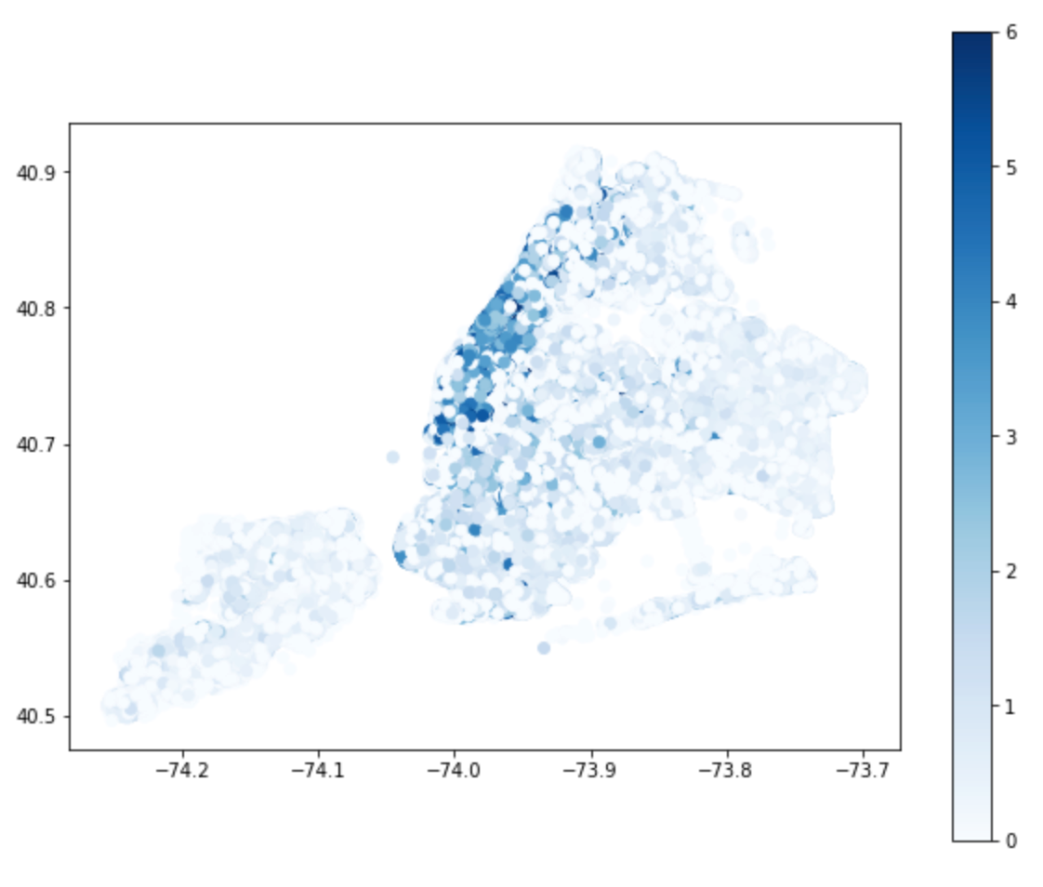
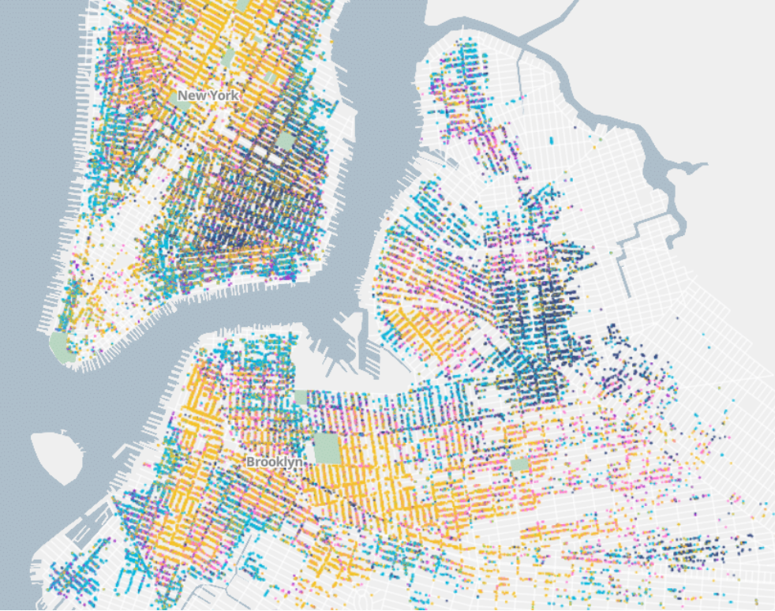
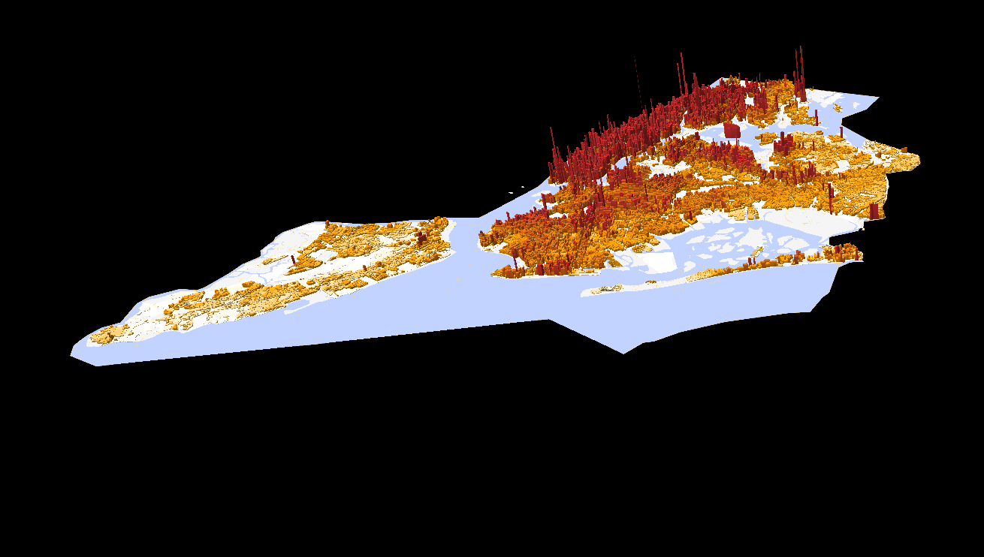
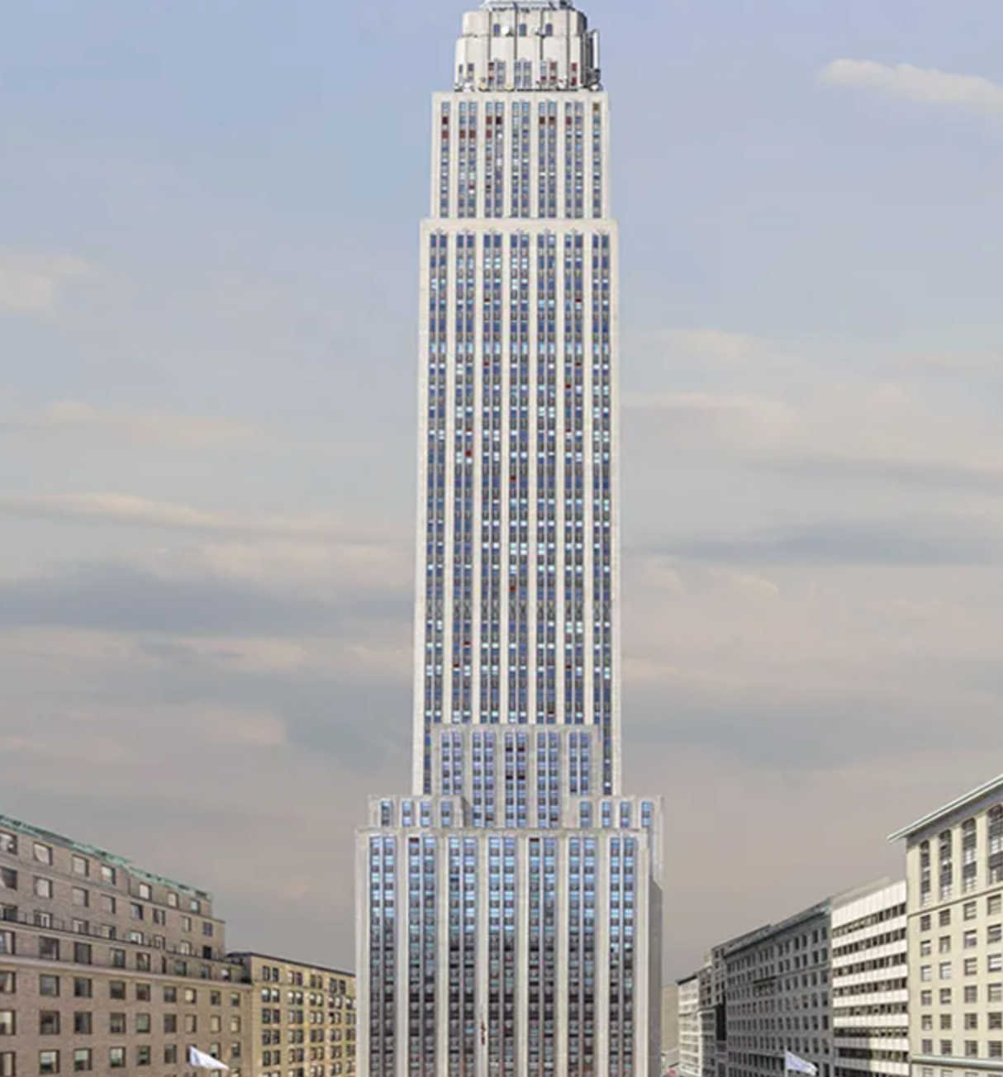
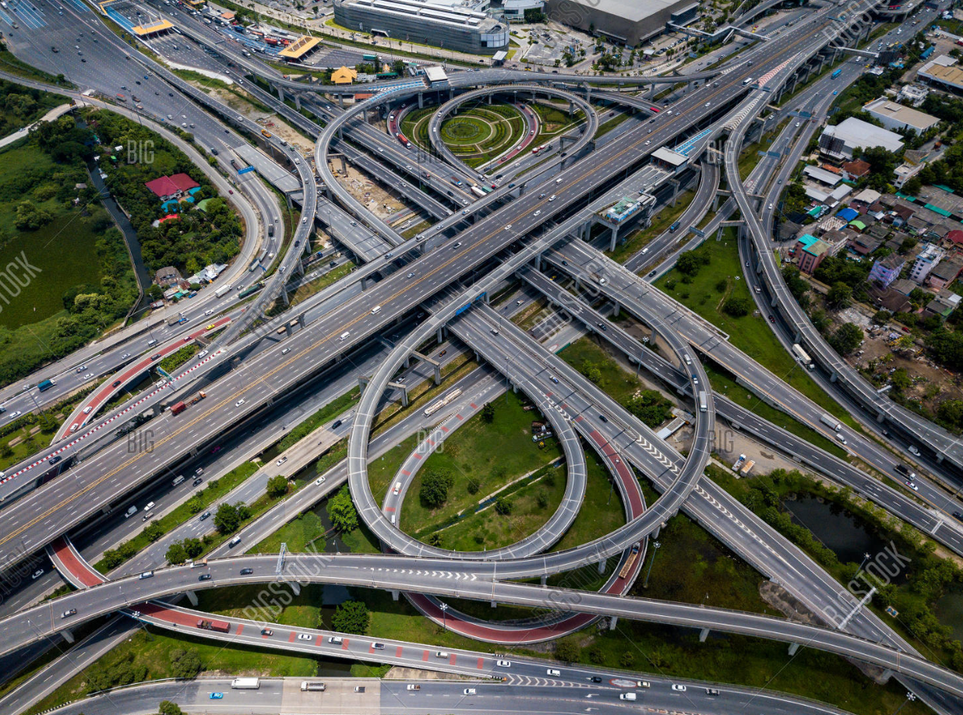
Methodology
New York Building Lot Density Map
New York Road Surface Area Density Map
New York Subsurface Density map
Transformation method by Alain Bertaud: Created surface density metrics and match them with road surface area from LION to show how to convert surface density to subsurface density.
&
Subsurface Density = Building Lot Density / Road Area
Notes:
Based on the transformation method by Bertuad, we created surface density metrics and match them with road surface area from LION to show how to convert surface density to subsurface density.
So basically, we divided building lot density with road area in order to get the subsurface density.
After looking at the methodology, my teammate will continue to explore the data section.

Slide 12
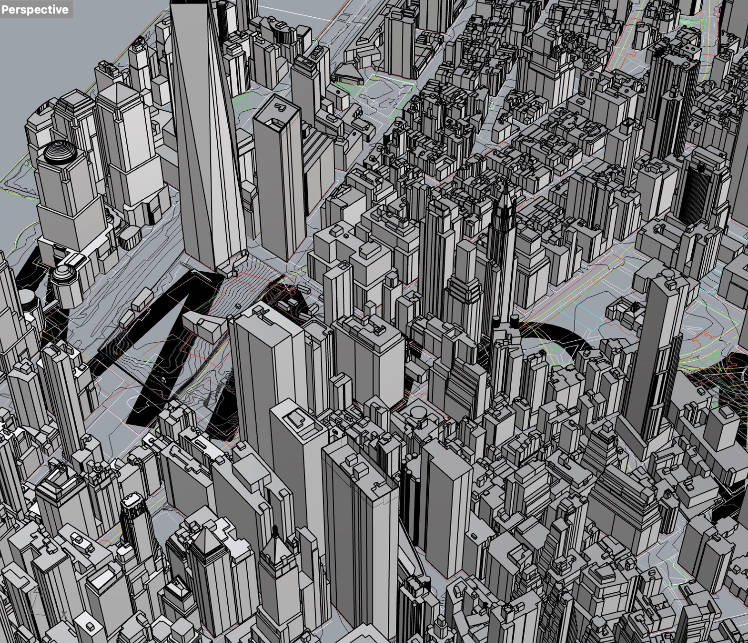
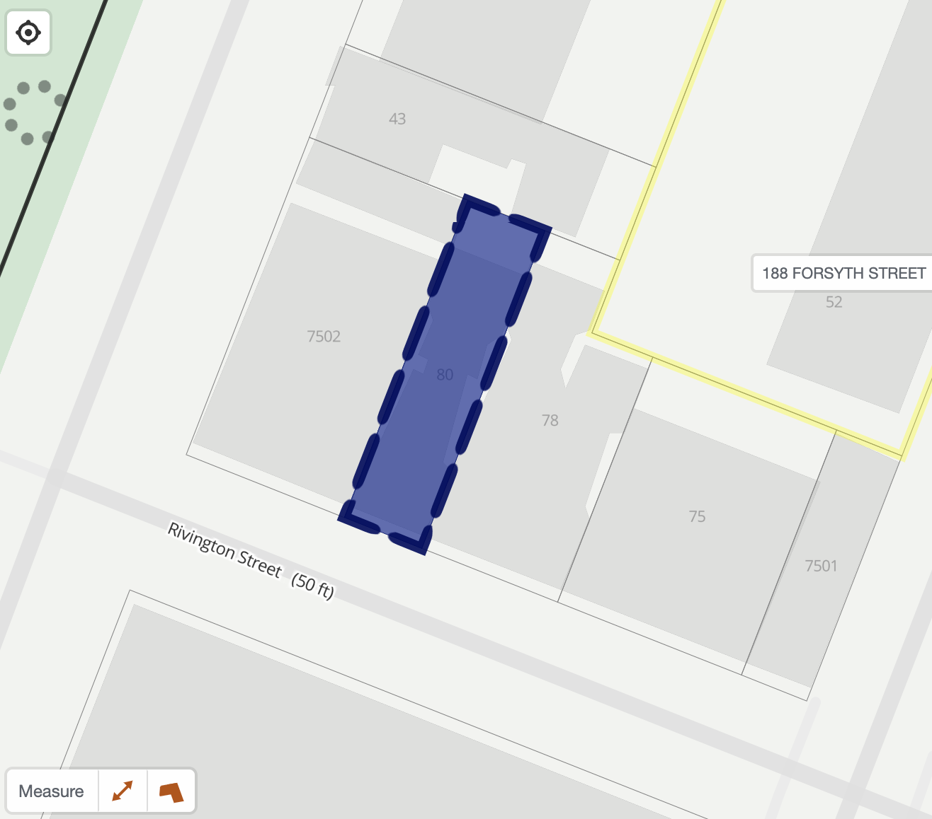
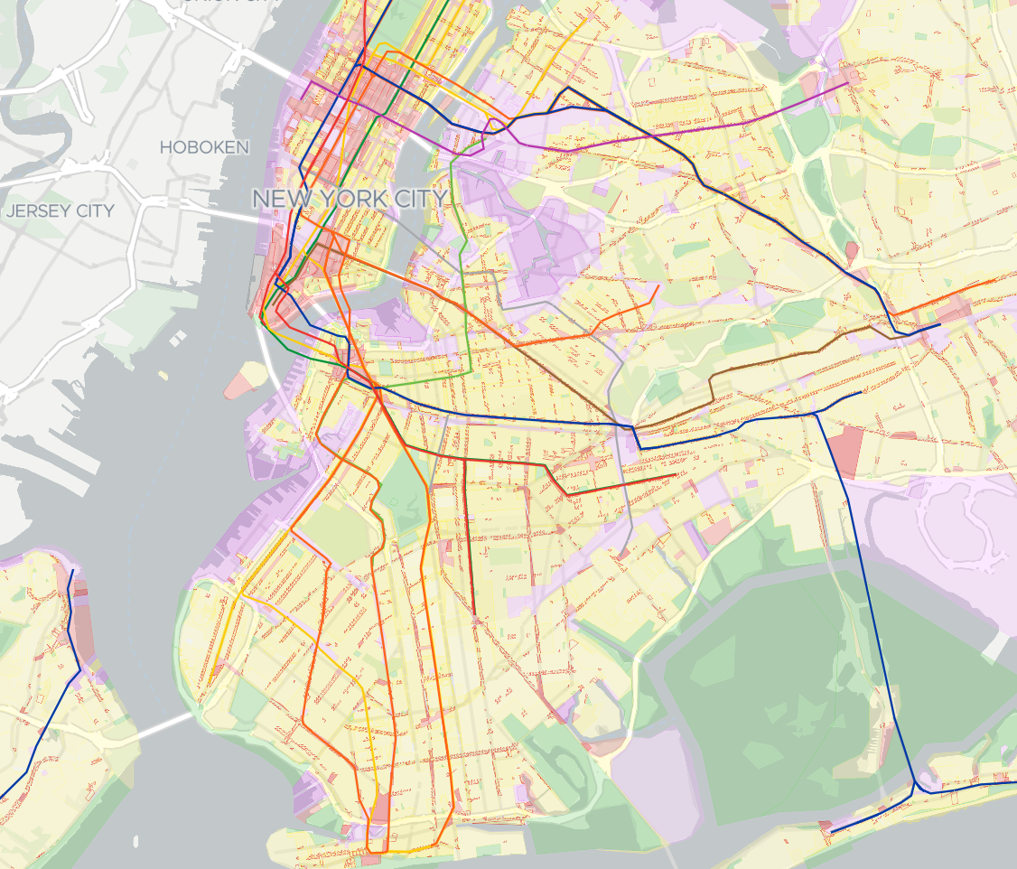
Data processing
The three datasets were processed using Rhino7, Python, and ArcGIS Pro( filtering missing data).
NYC 3D Model by Community District
NYC PLUTO DATA
LION Single Line Street Base Map
Notes:
Increasing aging subsurface infrastructures needs to be addressed and well managed.
Aging subsurface infrastructures vulnerability creates bring lots of potential risks and inconveniences.
Lack of subsurface infrastructure location data requires methodology using available surface data to suggest vulnerability.
The city's complex network of subsurface utility infrastructure, often referred to as the "subsurface Spaghetti," presents a formidable obstacle for utilities operating in this environment.

Slide 13
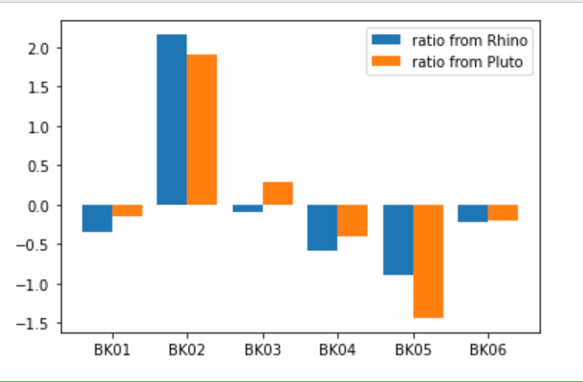
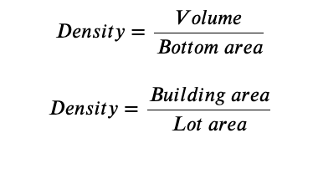
Cross validation Calculation
Cross validation result
Density from DCP 3D MODEL | 36.81836569 | 65.73728729 | 39.77941479 | 34.1031122 | 30.61089658 | 38.41869853
Density from PLUTO | 1.466339946 | 2.510099888 | 1.695279956 | 1.33671999 | 0.813844025 | 1.441550016
Kolmogorov-Smirnov Test： p-value of 0.93

Slide 14
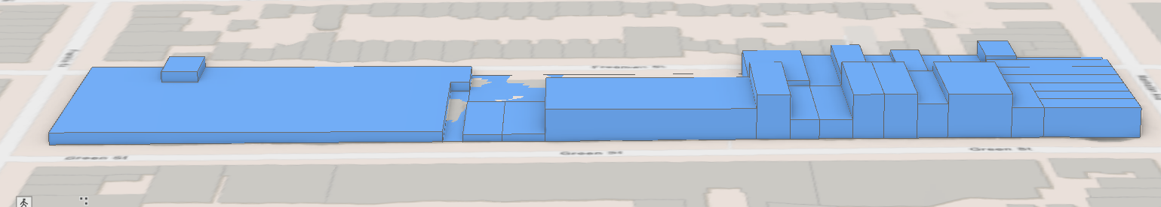
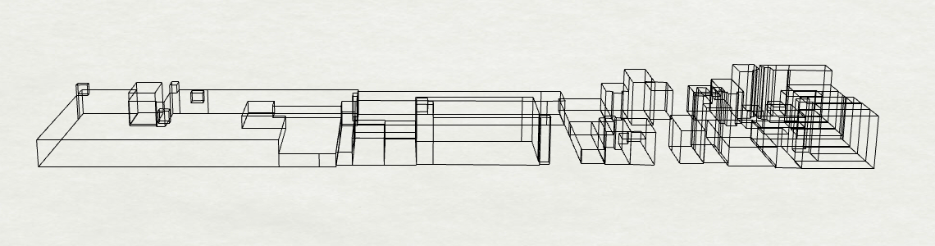
Cross validation：3D AND PLUTO front view

Slide 15
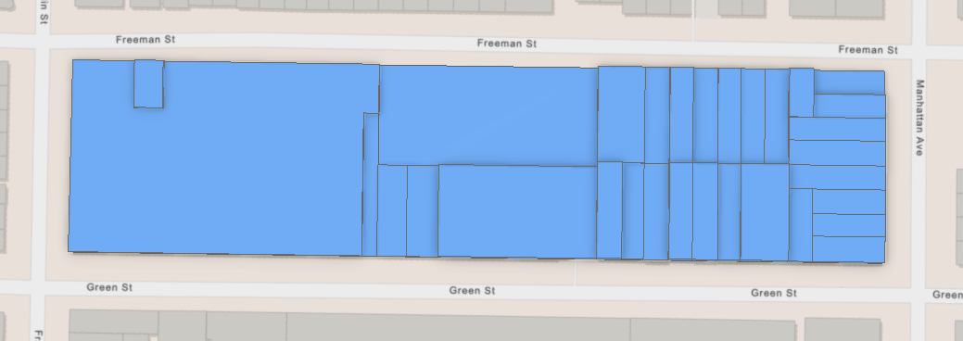
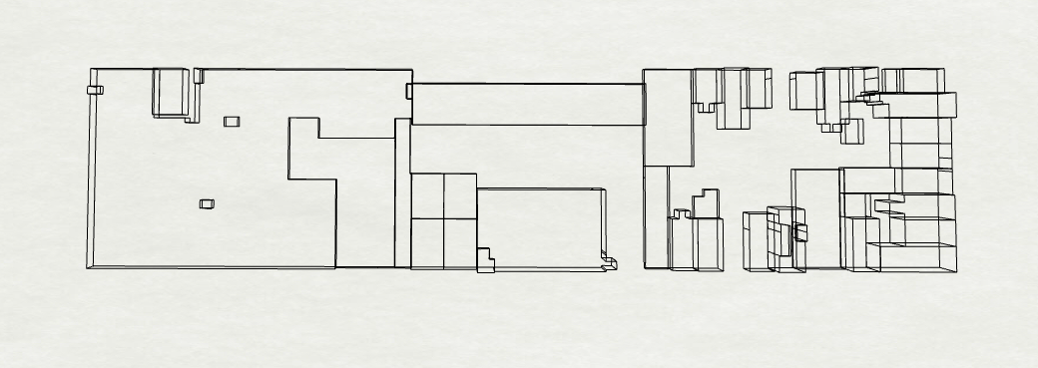
Cross validation：3D AND PLUTO top view

Slide 16
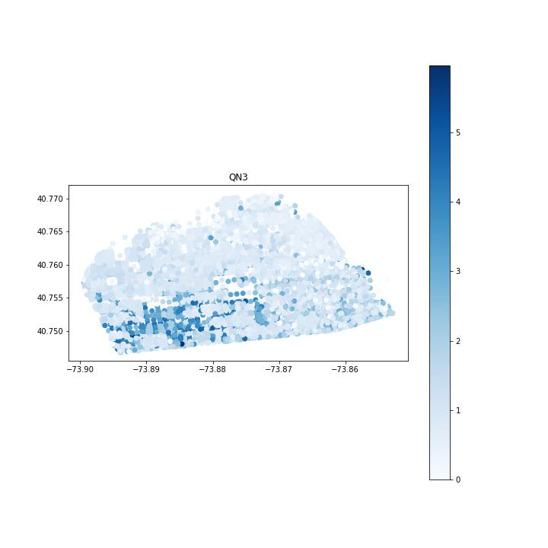
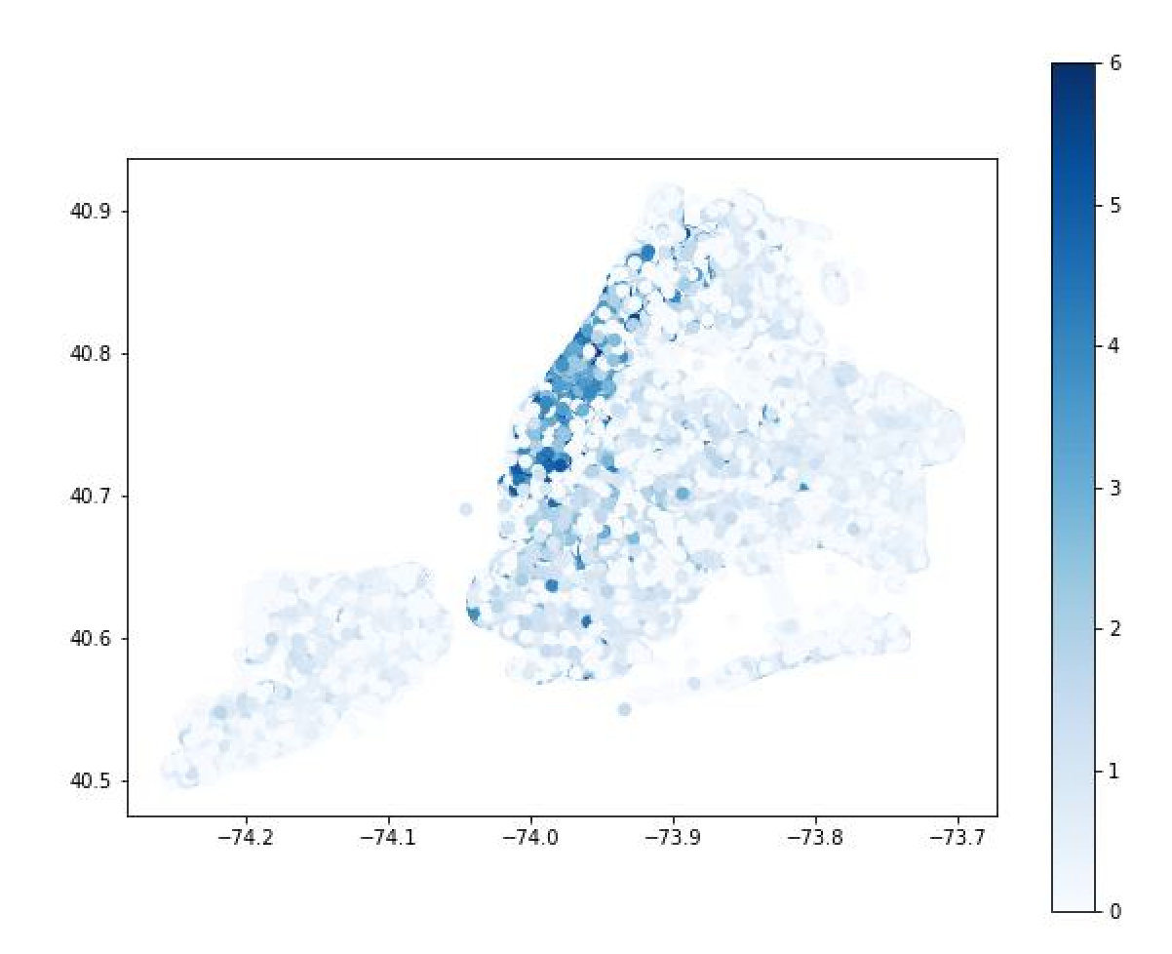
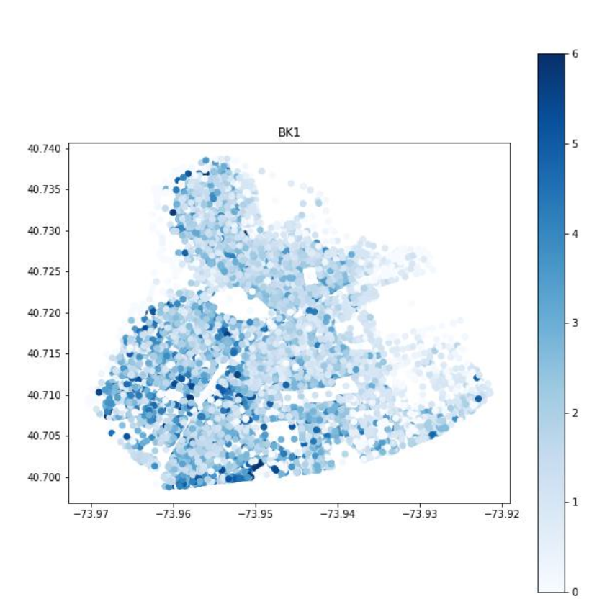
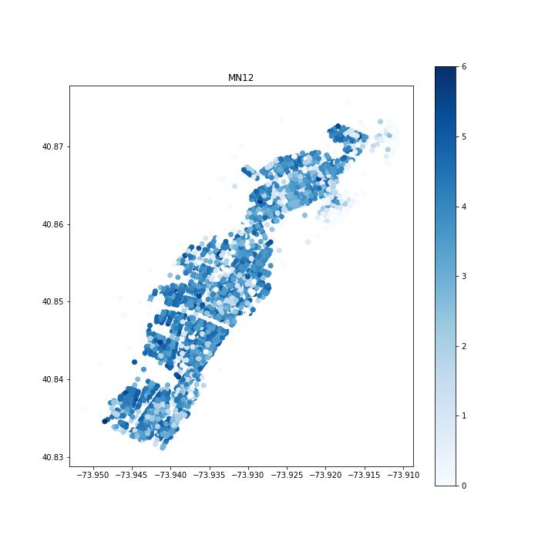
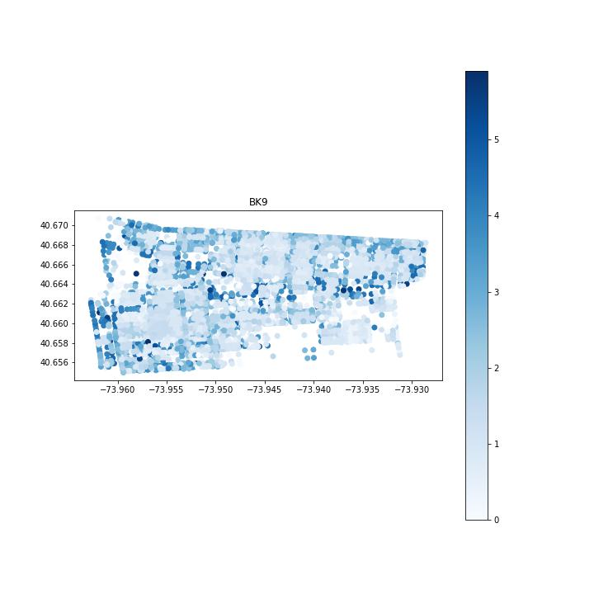
Density map at the individual district level
New York city
59 Districts

Slide 17
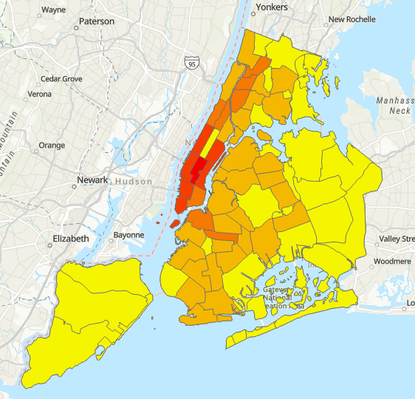
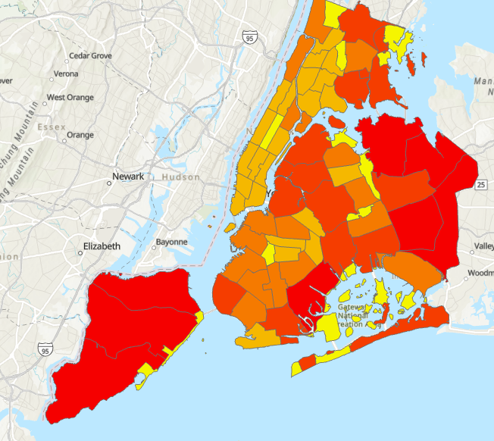
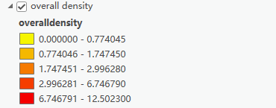
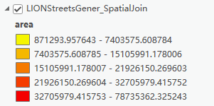
Surface density map
Road area map

Slide 18
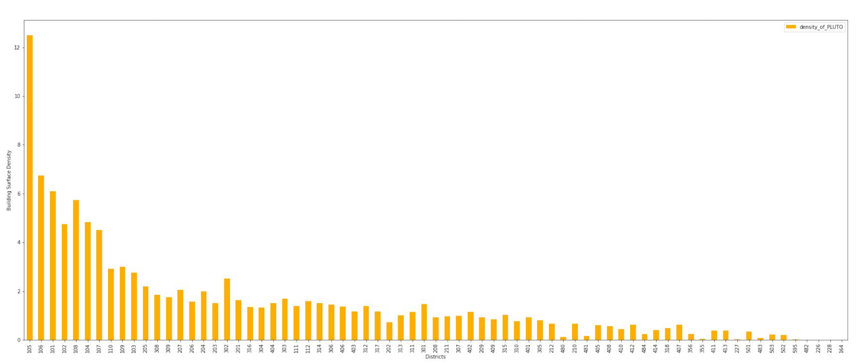
Surface density bar Chart from Pluto by CDs

Slide 19
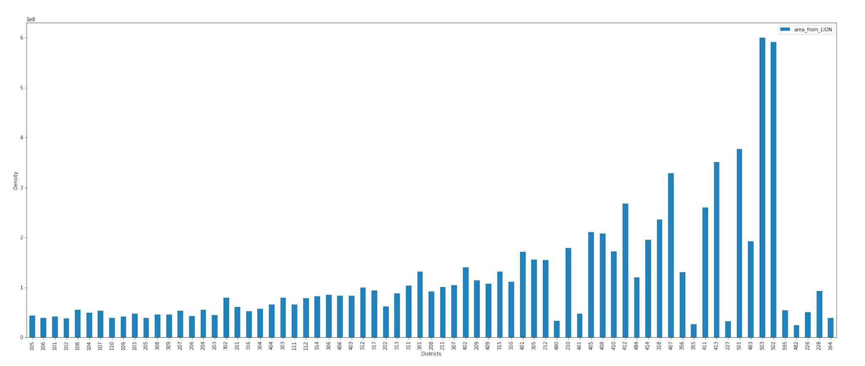
Road area bar chart from LION by CDs

Slide 20
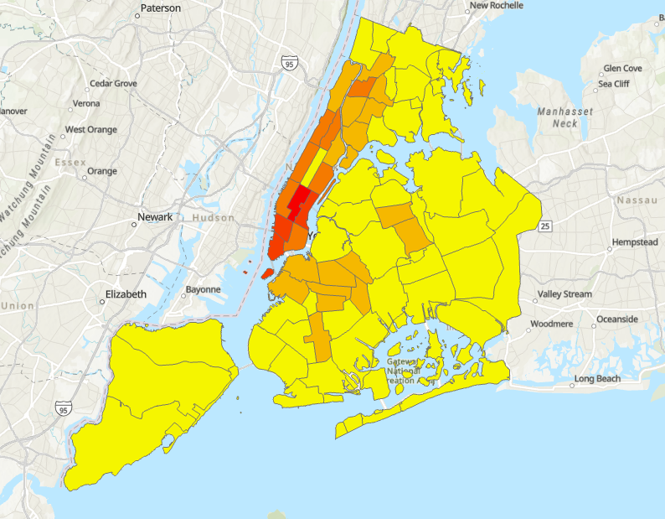
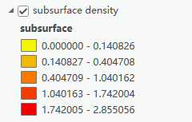
Subsurface density map by district view

Slide 21
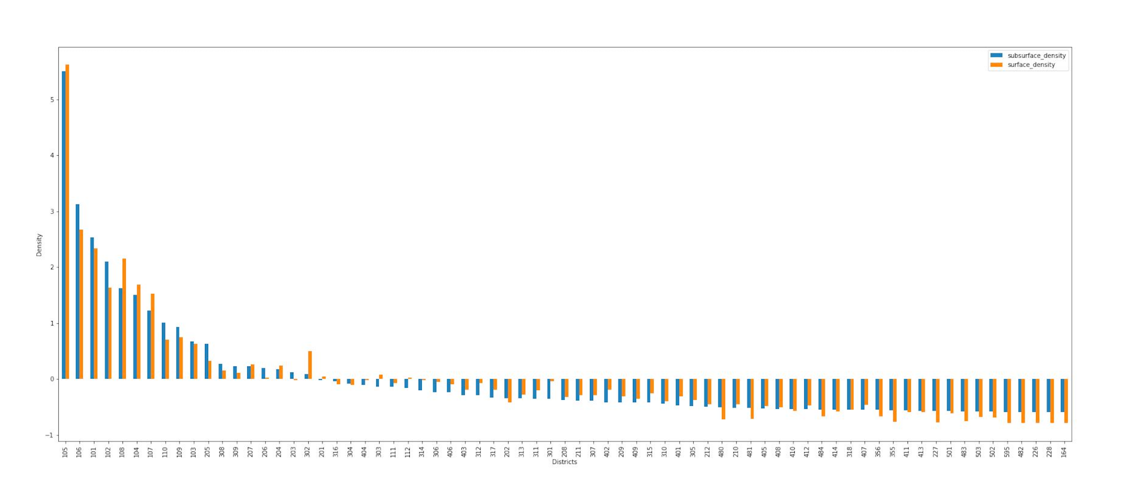
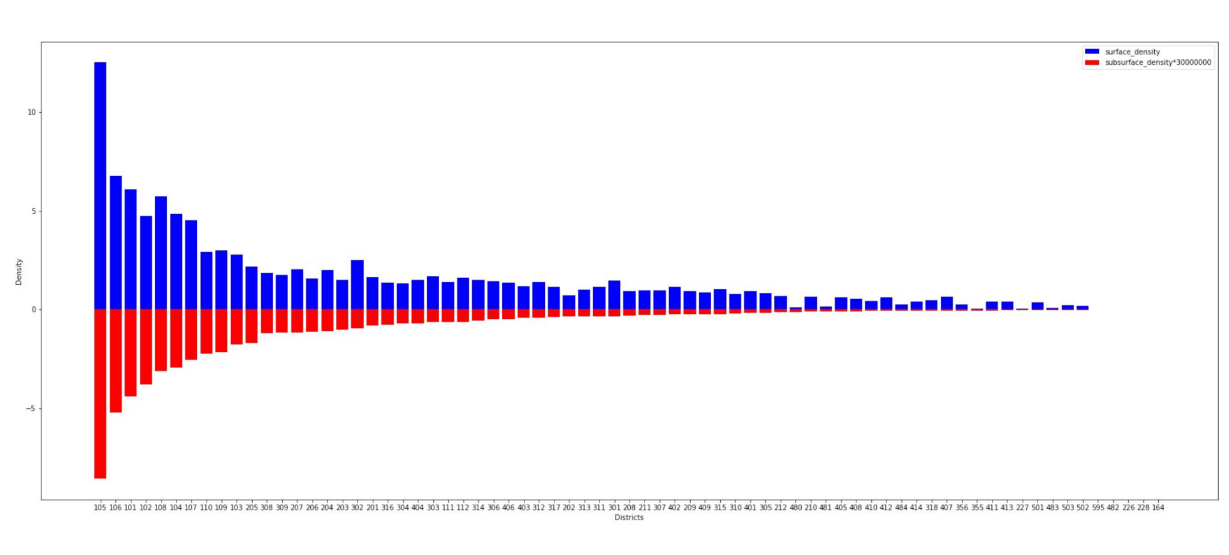
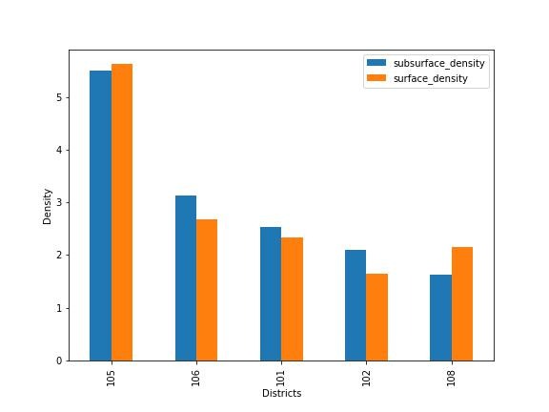
Standardized surface and subsurface densities
Top districts
Confirms the hypothesis that surface density directly reflects subsurface density by CDs

Slide 22
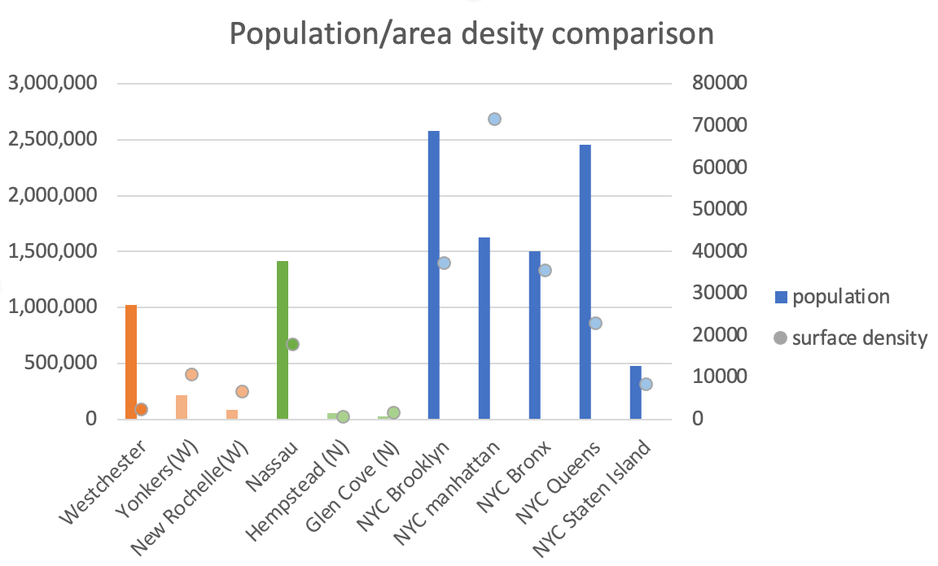
Case study: Westchester and Nassau
Permits a subsequent estimation of a utility pricing gap within NYC as compared to adjacent counties’ surface densities to support development of revenue sources to finance utilidors; some private utilities serve customers in NYC and other adjacent areas within their service areas.

Slide 23
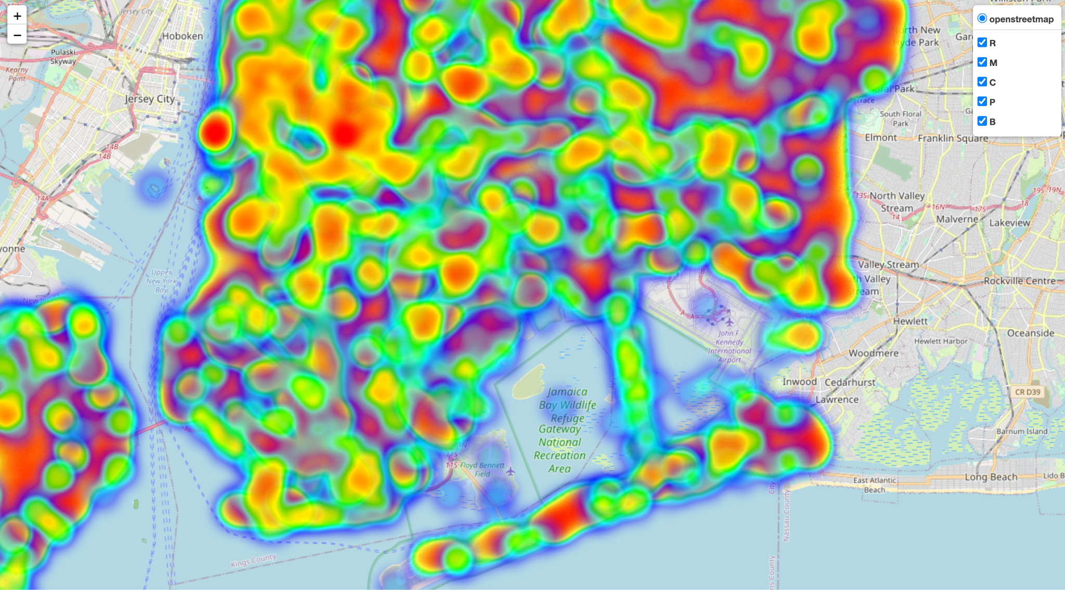
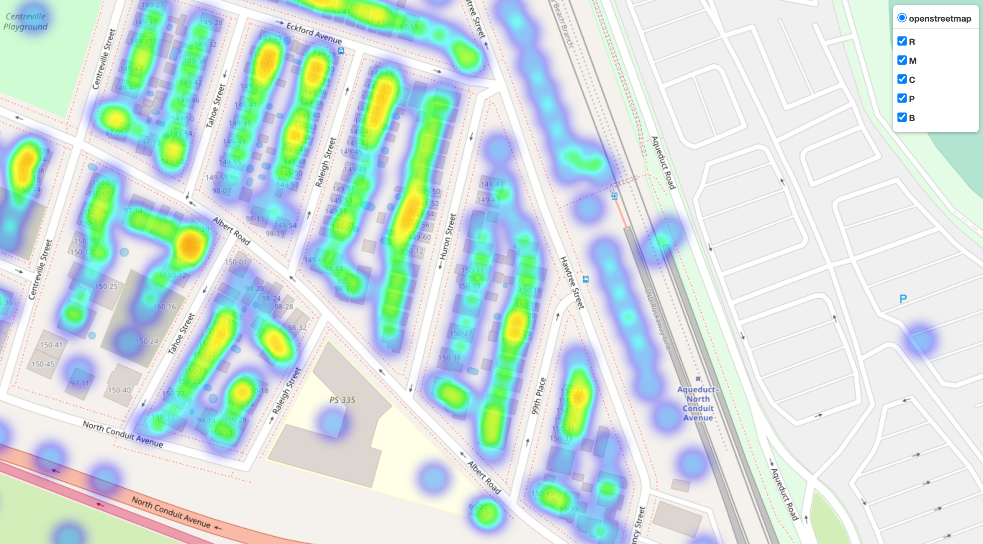
Interactive Surface Density Heatmap
Created a heat map that can be interacted with, we can obtain more details of the surface density distribution.

Slide 24
Project website and resources
https://zihao-wu999.github.io/reverse-engineering/
https://github.com/Zihao-Wu999/Reverse-Engineering-to-Estimate-Subsurface-Utility-Infrastructure-Density

Slide 25



Policy recommendations
Optimizing land use planning: Fully utilizing underground PROW space is vital for smart city development. It ensures efficient allocation of underground resources and supports sustainable infrastructure.
Supporting technological innovation: Governments can encourage innovation and research to improve utilidor design and operation. This includes funding R&D, establishing innovation centers, and promoting collaboration for technological advancements.
Changing utility tariffs: Modifying utility tariffs can provide funding for utilidor construction and maintenance. By considering the value of underground PROW and the costs of direct burial, appropriate pricing levels can be established to finance utilidor projects.

Slide 26
Conclusion
Theory proof: We have used Bertaud's economic based theory of surface densities within urban centers to successfully estimate a subsurface density map based on surface building that demonstrates the applicability of this method to New York City.
Visualization tools: Different visualisation tools were obtained, which can support subsequent studies
Future policy development: Theoretical support for maintaining a sustainable revenue base is suggested, for example by changing utility tariffs. This project can also provide support for urban planning optimisation.
Notes:
Increasing aging subsurface infrastructures needs to be addressed and well managed.
Aging subsurface infrastructures vulnerability creates bring lots of potential risks and inconveniences.
Lack of subsurface infrastructure location data requires methodology using available surface data to suggest vulnerability.
The city's complex network of subsurface utility infrastructure, often referred to as the "subsurface Spaghetti," presents a formidable obstacle for utilities operating in this environment.

Slide 27
Reference
Frederiksen, P. C. (1981). Further evidence on the relationship between population density and infrastructure: The Philippines and electrification. Economic Development and Cultural Change, 29(4), 749–758. https://doi.org/10.1086/451289
Bobylev, N. (2016). Underground space as an urban indicator: Measuring use of Subsurface. Tunnelling and Underground Space Technology, 55, 40–51. https://doi.org/10.1016/j.tust.2015.10.024
von der Tann, L., Metje, N., Admiraal, H., &amp; Collins, B. (2018). The hidden role of the subsurface for cities. Proceedings of the Institution of Civil Engineers - Civil Engineering, 171(6), 31–37. https://doi.org/10.1680/jcien.17.00028
Building better streets. RPA. (n.d.). Retrieved May 3, 2023, from https://rpa.org/work/reports/building-better-streets#recommendations-and-case-studies
Figure 4. Disney Magic Kingdom Utilidors. Adapted from “Beneath The Magic: What Happens In The Magic Kingdom Utilidors?”by L.Sikes,2020,WDW Blog.Retrieved from https://www.wdw-magazine.com/beneath-the-magic-what-happens-in-the-magic-kingdom-utilidors/
Bertaud, A. (2018). Order without Design: Vol. pp. 7, 8. Cambridge: MIT Press.

Slide 28
THANK
YOU
!

